Slide 1

Social Buzz
Analysis Presentation
Ahad Rehman(Data Analyst)
B.Tech CS&E, Sem 7
A7605220005

Slide 2
Agenda for the Presentation
Project recap
Problem Analytics team Process Insights Summary

Slide 3
Project Recap
Social Buzz is a global unicorn technology company growing at an accelerated rate. Accenture has embarked in a 3 month work pilot to help tackle their biggest challenges which include:
✔ Audit of Social Buzz Big data practice
✔ Analysis of top 5 popular categories content

Slide 4


Problem
Social Buzz has reached over 100,000 posts per day which take us to 36,500,000 pieces of content per year!
But how do we capitalize on it when there is so much?

Slide 5
The Analytics Team
Andrew Fleming
Chef Technical Architect
Marcus Rompton
Senior Data Expert
Ahad Rehman
Data Analyst

Slide 6
Process
1₁. Understanding problem
22. Data Cleaning
33. Data Modelling
44. Data Analysis
5₅. Data Visualization to uncover insights

Slide 7
After carefully reviewing and understanding the project requirements, the CSV ﬁles were loaded into Excel followed by SAS for processing.
Data cleaning was performed, missing values were handled, erroneous & duplicate entries were removed. The datasets reactions, reaction type, and content were merged based on key values prior the analysis, data visualization was carried out using Tableau software.

Slide 8
Insights
The analysis results shows 16 categories of post across the entire dataset. There was 1969 animals posts alone telling us there are lots of animals lover out there. The result also shows January scored the highest number of posts of 2218 which is interesting to see how active people are even after the big holidays season.
Unique Categories 16
Reactions to "animals"
1969
Month with highest posts
January

Slide 9

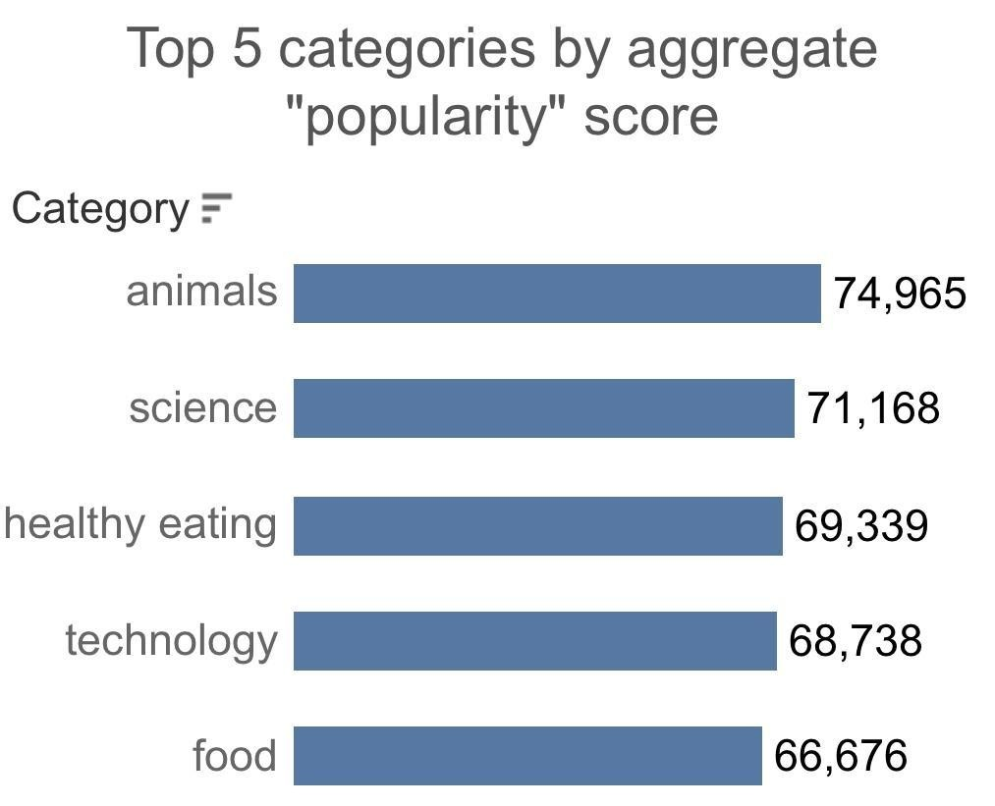

The top 5 most popular categories of content were animals, science, healthy eating, technology, and food. Animals had an aggregate popularity score of 74,965.
It's fascinating to see both animals
and science within the top 5, this shows that people like seeing real-life content the most. No wonder healthy eating made it to
the top 5 as many people are very keen when it comes to making healthy choices.

Slide 10

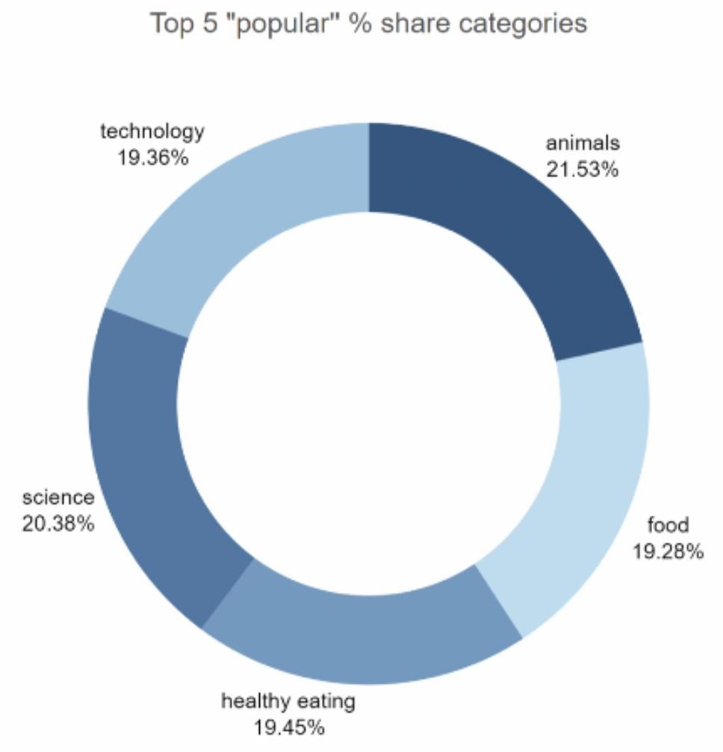

We can see that there isn't a big difference from the chart split between popularity of the top 5 categories. The ﬁrst largest percentage animals outperformed the second largest one science
by 1.1%.

Slide 11
Recommendations
Animals and science were two of the most popular content categories with healthy eating ranking as the third one. We recommend creating more content related to those categories to boost user engagements.
Healthy eating can be placed in same category as "food". We suggest collaborating with healthy food brands to help bring brand awareness and to reach wider audience.
With this technology age, there is no surprise to see technology in top 5 categories. It shows that users enjoy tech contents. Collaborating through brands partnership with tech companies will deﬁnitely increase engagement rates.

Slide 12
Thank you!

